Slide 1

METHODS IN JAVA
An Introduction

Slide 2
OBJECTIVES
Define method, parameters and arguments.
Discuss how methods are used in writing programs in Java.
Write a Java program implementing methods.
Compare programs written in Java using methods and without methods.

Slide 3
OPENING PROBLEM
Find the sum of integers from 1 to 10, from 20 to 30, and from 35 to 45, respectively.
3

Slide 4
PROBLEM
int | sum | = |  | 0;
for | (int |  | i | = | 1; | i | <= | 10; | i++)
sum += i;
System.out.println("Sum from 1 to 10 is " + sum);
sum = 0;
for (int i = 20; i <= 30; i++) sum += i;
System.out.println("Sum from 20 to 30 is " + sum);
sum = 0;
for (int i = 35; i <= 45; i++) sum += i;
System.out.println("Sum from 35 to 45 is " + sum);
4

Slide 5
PROBLEM
int | sum | = | 0;
for (int sum += |  | i i | = ; |  | 1; i <= |  | 10; i++)
System.out.println("Sum from 1 to
sum = 0; for (int sum += |  | i i; |  | = | 20; i | <= | 30; i++)
10 is " + sum);
System.out.println("Sum from 20 to 30 is " + sum);
sum = 0;
for (int i = 35; i <= 45; i++) sum += i;
System.out.println("Sum from 35 to 45 is " + sum);
5

Slide 6
SOLUTION
public static int sum(int i1, int i2) {
int sum = 0;
for (int i = i1; i <= i2; i++) sum += i;
return sum;
}
public static void main(String[] args) { System.out.println("Sum from 1 to 10 is " + sum(1, 10)); System.out.println("Sum from 20 to 30 is " + sum(20, 30)); System.out.println("Sum from 35 to 45 is " + sum(35, 45));
}
6

Slide 7
WHAT IS A METHOD?
A method is a block of code which only runs when it is called.
A method is a collection of statements that are grouped together to perform an operation.
You can pass data, known as parameters, into a method.
Methods are used to perform certain actions, and they are also known as functions.
Why use methods? To reuse code: define the code once and use it many times.

Slide 8
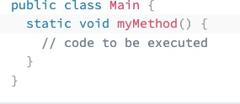
CREATE A METHOD
Example: Create a method inside Main:
A method must be declared within a class. It is defined with the name of the method, followed by parentheses ().
Java provides some pre-defined methods, such as System.out.println(), but you can also create your own methods to perform certain actions:

Slide 9
EXAMPLE EXPLAINED
myMethod() is the name of the method
static means that the method belongs to the Main class and not an object of the Main class.
void means that this method does not have a return value.

Slide 10
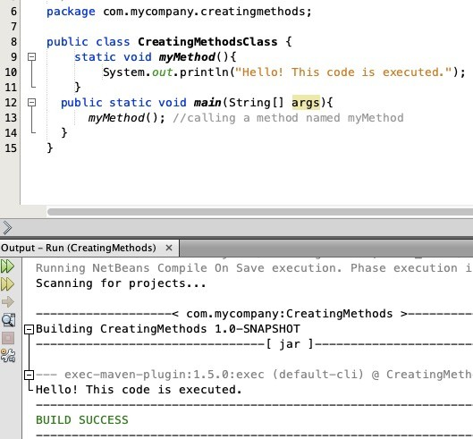
CALL A METHOD
Inside main, call the myMethod() method:
To call a method in Java, write the method's name followed by two parentheses () and a semicolon;
In the following
example, myMethod() is used to print a text (the action), when it is called:

Slide 11
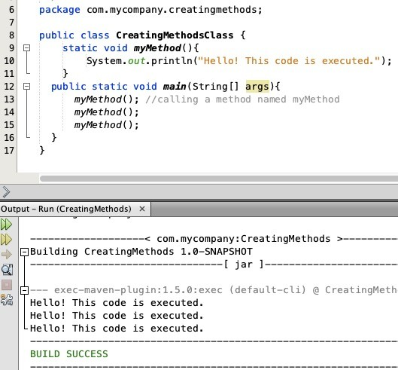
A METHOD CAN ALSO BE CALLED MULTIPLE TIMES:

Slide 12
PARAMETERS AND ARGUMENTS
Information can be passed to methods as parameter.
Parameters act as variables inside the method.
Parameters are specified after the method name, inside the parentheses. You can add as many parameters as you want, just separate them with a comma.

Slide 13
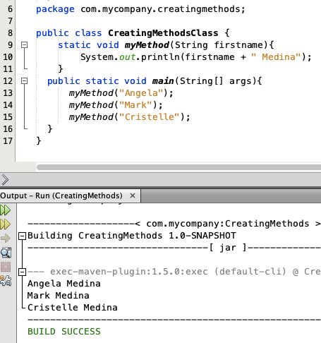
PARAMETERS AND ARGUMENTS
The following example has a method that takes
a String called firstname as parameter.
When the method is called, we pass along a first name, which is used inside the method to print the full name:

Slide 14
PARAMETERS AND ARGUMENTS
When a parameter is passed to the method, it is called
an argument. So, from the example: firstname is
a parameter, while Angela,
Mark and Cristelle are arguments.

Slide 15
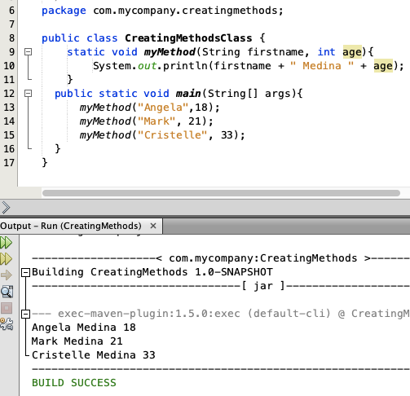
MULTIPLE PARAMETERS
You can have as many parameters as you like:

Slide 16
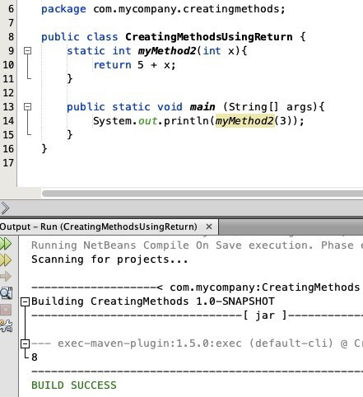
RETURN VALUES
The void keyword, used in the examples above, indicates that the method should not return a value.
If you want the method to return a value, you can use a primitive data type (such as int, char, etc.) instead of void, and use the return keyword inside the method:

Slide 18
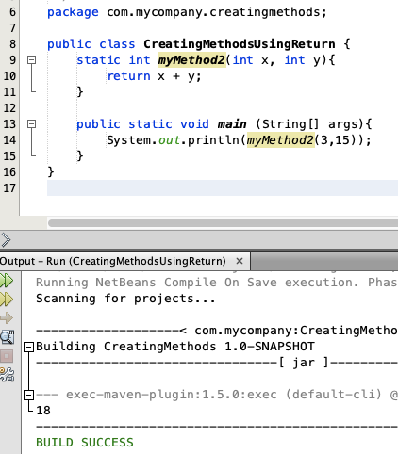
THIS EXAMPLE RETURNS THE SUM OF A METHOD'S TWO PARAMETERS:

Slide 19
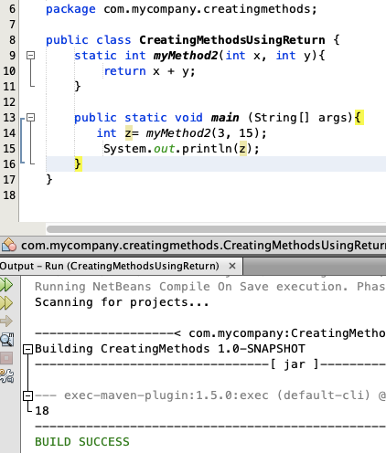
You can also store the result in a variable (recommended, as it is easier to read and maintain):

Slide 20
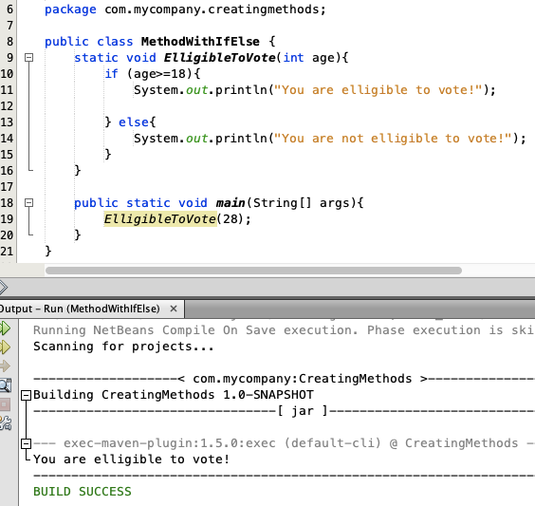
A METHOD WITH IF...ELSE
It is common to
use if...else statements inside methods:

Slide 21
JAVA METHOD OVERLOADING
With method overloading, multiple methods can have the same name with different parameters:
Example:
int myMethod(int x) float myMethod(float x)
double myMethod(double x, double y)

Slide 22
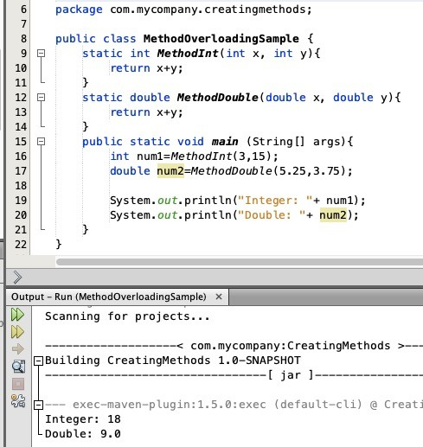
JAVA METHOD OVERLOADING
Consider the following example, which has two methods that add numbers of different type:

Slide 23
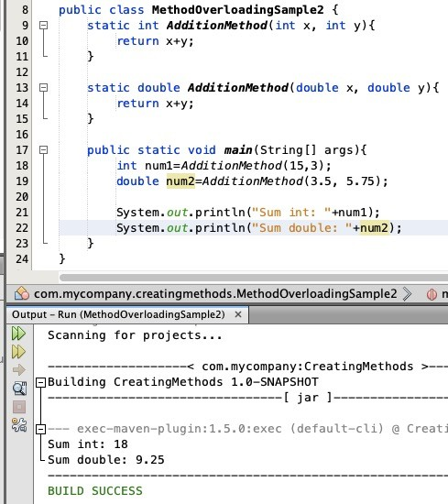
JAVA METHOD OVERLOADING
Instead of defining two methods that should do the same thing, it is better to overload one.
In the example below, we overload
the AdditionMethod method to work for
both int and double:

Slide 24


Slide 25
JAVA SCOPE
In Java, variables are only accessible inside the region they are created.
This is called scope.

Slide 26
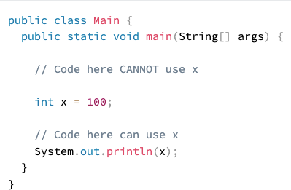
METHOD SCOPE
Variables declared directly inside a method are available anywhere in the method following the line of code in which they were declared:

Slide 27
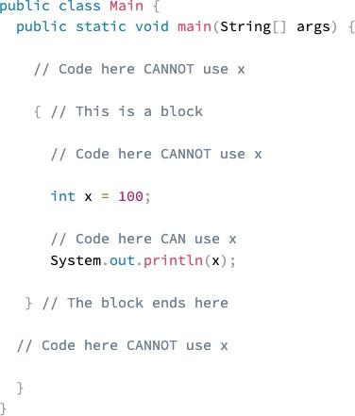
BLOCK SCOPE
A block of code refers to all of the code between curly braces {}.
Variables declared inside blocks of code are only accessible by the code between the curly braces, which follows the line in which the variable was declared:

Slide 28
BLOCK SCOPE
A block of code may exist on its own or it can belong to an if, while or for statement.
In the case of for statements, variables declared in the statement itself are also available inside the block's scope.

Slide 29
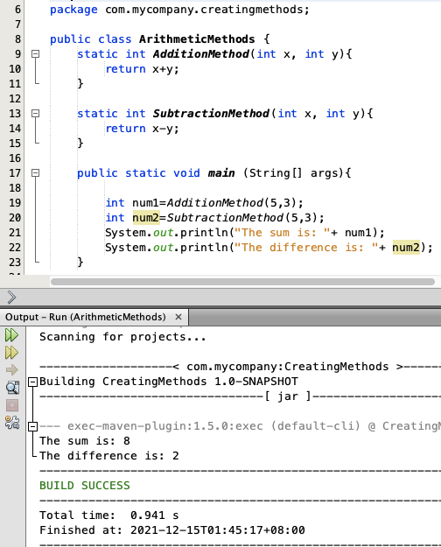
SAMPLE PROGRAM USING METHODS

Slide 30

YOUR ASSIGNMENT:
Based on the given sample program, add a method to multiply two integers and a method to divide two integers.
Apply method overloading to minimize the given sample code.

Slide 31
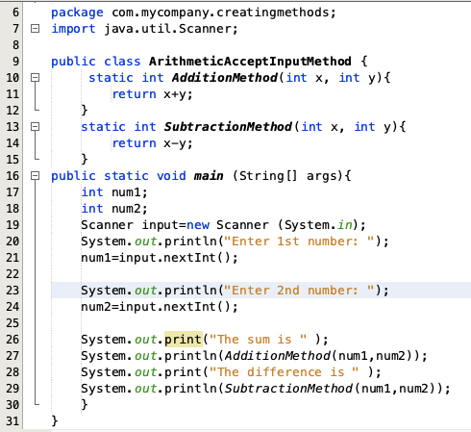
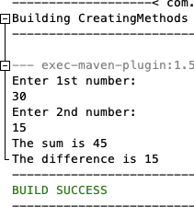
ACCEPTING INPUT FROM THE USER

Slide 32
REFERENCES:
https://www.w3schools.com/java/java_methods.asp

